Slide 1
LLMOps on Databricks
Notes:
Accompanying slide deck to the Big Book of MLOps V2
Internal doc - Big Book of MLOps V2

Slide 2
LLMOps - Outline
What changes with LLMs?
Key components of LLM-powered applications
Prompt engineering
RAG
Vector databases
Third-party APIs vs self-hosted models
Evals
Packaging models/pipelines for deployment
Inference
Managing cost/performance trade-offs
Reference architecture
Resources

Slide 3
LLMOps
What changes with LLMs?
Key components of LLM-powered applications
Prompt engineering
RAG
Vector databases
Fine-tuning LLMs
Pre-training from scratch
Third-party APIs vs self-hosted models
Evals
Packaging models/pipelines for deployment
Inference
Managing cost/performance trade-offs
Reference architecture
Resources

Slide 4
MLOps - What changes with LLMs?
Properties of LLMs | Implications for MLOps
LLMs are available in many forms: General proprietary and OSS models via paid APIs Off-the-shelf open source models Custom models fine-tunes for specific applications Custom pre-trained models | Development process: Incremental development Starting from APIs through to custom models

Slide 5
MLOps - What changes with LLMs?
Properties of LLMs | Implications for MLOps
LLMs are available in many forms: General proprietary and OSS models via paid APIs Off-the-shelf open source models Custom models fine-tunes for specific applications Custom pre-trained models | Development process: Incremental development Starting from APIs through to custom models
LLMs take natural language prompts as input: Prompts can be engineered to elicit desired response | Development process: Designing test templates for querying LLMs forms important part of development process Packaging artifacts: Artifacts packaged and promoted to production may be pipelines rather than models

Slide 6
MLOps - What changes with LLMs?
Properties of LLMs | Implications for MLOps
LLMs are available in many forms: General proprietary and OSS models via paid APIs Off-the-shelf open source models Custom models fine-tunes for specific applications Custom pre-trained models | Development process: Incremental development Starting from APIs through to custom models
LLMs take natural language prompts as input: Prompts can be engineered to elicit desired response | Development process: Designing test templates for querying LLMs forms important part of development process Packaging artifacts: Artifacts packaged and promoted to production may be pipelines rather than models
LLMs can be given prompts with examples and/or context | Serving infrastructure: External tools such as vector databases used to search for relevant context

Slide 7
MLOps - What changes with LLMs?
Properties of LLMs | Implications for MLOps
Proprietary and OSS models available via third-party API providers | API governance: In order to have optionality and flexibility to switch between API providers, it becomes important to have a centralized system for API governance.

Slide 8
MLOps - What changes with LLMs?
Properties of LLMs | Implications for MLOps
Proprietary and OSS models available via third-party API providers | API governance: In order to have optionality and flexibility to switch between API providers, it becomes important to have a centralized system for API governance.
LLMs are very large deep learning models, often ranging from gigabytes to hundreds of gigabytes | Serving infrastructure: LLMs require GPUs for serving If models need to be dynamically loaded, fast storage becomes essential

Slide 9
MLOps - What changes with LLMs?
Properties of LLMs | Implications for MLOps
Proprietary and OSS models available via third-party API providers | API governance: In order to have optionality and flexibility to switch between API providers, it becomes important to have a centralized system for API governance.
LLMs are very large deep learning models, often ranging from gigabytes to hundreds of gigabytes | Serving infrastructure: LLMs require GPUs for serving If models need to be dynamically loaded, fast storage becomes essential
LLMs are hard to evaluate via traditional ML metrics since there is often no single “right” answer | Human feedback: Often required for evaluating and testing LLMs Important to incorporate this directly into the MLOps process, including testing, monitoring, for use in future fine-tuning.

Slide 10





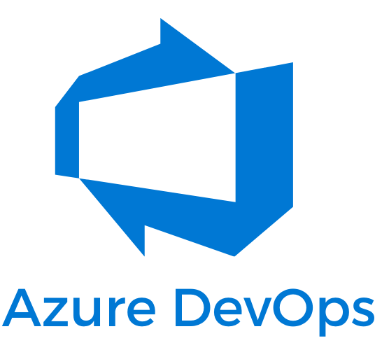

MLOps - What changes with LLMs?
Many existing tools and processes only require small adjustments to adapt to these new requirements
Separation of development, staging and production remains the same
Git version control and the MLflow Model Registry in Unity Catalog remain the primary conduits for promoting pipelines and models toward production.
The Lakehouse architecture for managing data remains valid and essential for efficiency.
Existing CI/CD infrastructure should not require changes.
The modular structure of MLOps remains the same, with pipelines for model training, model inference, etc.
Lakehouse Platform
Unity Catalog
DataOps
ModelOps
DevOps
development
staging
production

Slide 11
LLMOps
What changes with LLMs?
Key components of LLM-powered applications
Prompt engineering
RAG
Vector databases
Third-party APIs vs self-hosted models
Evals
Packaging models/pipelines for deployment
Inference
Managing cost/performance trade-offs
Reference architecture
Resources

Slide 12
LLMOps
What changes with LLMs?
Key components of LLM-powered applications
Prompt engineering
RAG
Vector databases
Third-party APIs vs self-hosted models
Evals
Packaging models/pipelines for deployment
Inference
Managing cost/performance trade-offs
Reference architecture
Resources

Slide 13

Prompt engineering
LLMOps - Key components
Prompt engineering is the practice of adjusting the text prompts given to an LLM to elicit more accurate or relevant responses.
Prompt
Output

Slide 14
Prompt engineering
LLMOps - Key components
Prompt
Output
Prompts are model-specific
A prompt given to two different models will generally not produce the same output

Slide 15
Prompt engineering
LLMOps - Key components
Prompt
Output
Prompts are model-specific
A prompt given to two different models will generally not produce the same output
Approach to prompt engineering: go from simple to complex
Track: Track queries and responses (MLflow LLM Tracking)
Templatize: Prompt templates (LangChain, LlamaIndex)
Automate: Automated prompt development (DSPy)

Slide 16
Prompt engineering
LLMOps - Key components
Prompt
Output
Prompts are model-specific
A prompt given to two different models will generally not produce the same output
Approach to prompt engineering: go from simple to complex
Track: Track queries and responses (MLflow LLM Tracking)
Templatize: Prompt templates (LangChain, LlamaIndex)
Automate: Automated prompt development (DSPy)
General tips:
Use clear, concise prompts.
May include instruction, context, user input, and description of desire output type/format
Provide examples (“few-shot” learning)
Tell the model how to behave (“admit when you do not know the answer”)
Tell the model to think step-by-step
Use techniques to prevent prompt hacking

Slide 17
Leveraging your own data
LLMOps - Key components
While prompt engineering can yield remarkable results, it might not always suffice
Domain-specific knowledge
Frequently updated contextual data
Incorporating proprietary data into LLM-powered applications:
Can enhance model performance
Provide a strategic edge

Slide 18
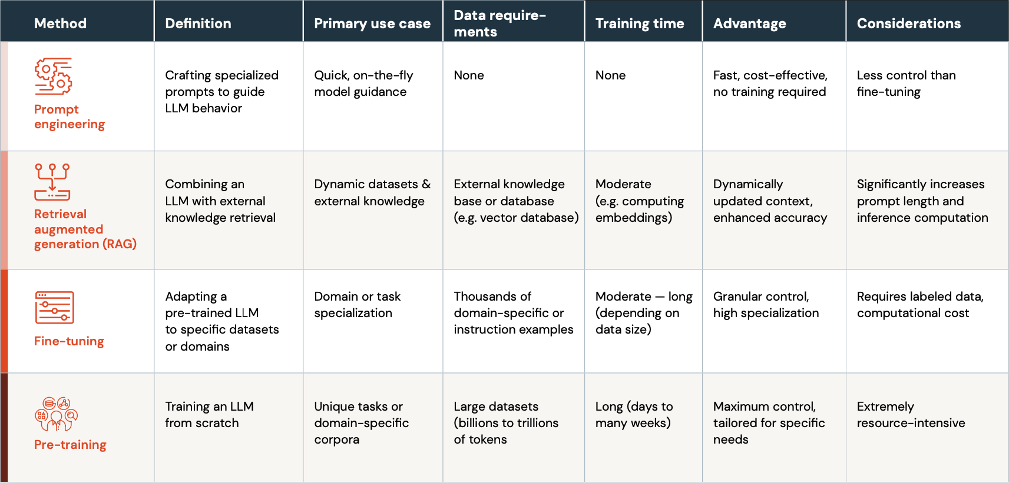
Leveraging your own data
LLMOps - Key components
LLM Continuum

Slide 19
Leveraging your own data
LLMOps - Key components
LLM Continuum

Slide 20
Leveraging your own data
LLMOps - Key components
LLM Continuum

Slide 21
Leveraging your own data
LLMOps - Key components
LLM Continuum

Slide 22
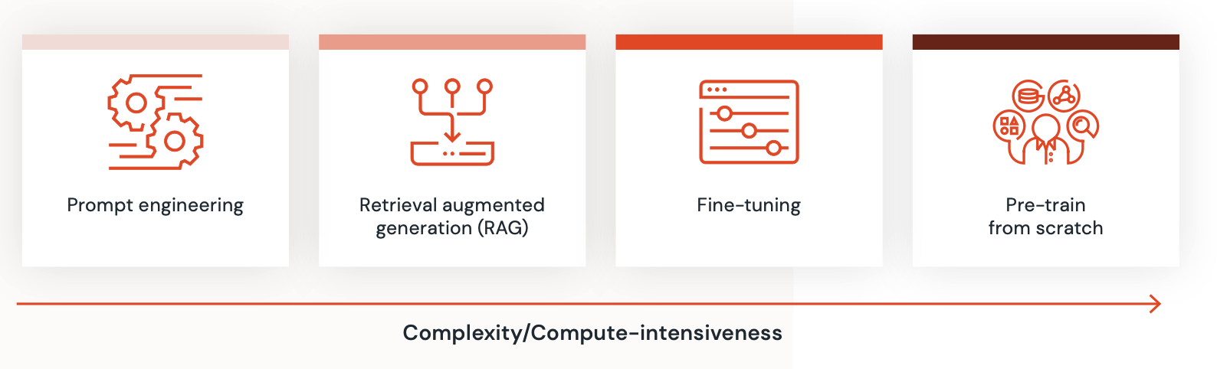
Leveraging your own data
LLMOps - Key components
LLM Continuum
Not mutually exclusive of one another
Start simple, create a baseline, iterate
Choice of technique informed by:
Volume and quality of data
Required application response time
Compute resources available
Specific domain or application at hand

Slide 23
LLMOps
What changes with LLMs?
Key components of LLM-powered applications
Prompt engineering
RAG
Vector databases
Fine-tuning LLMs
Pre-training from scratch
Third-party APIs vs self-hosted models
Evals
Packaging models/pipelines for deployment
Inference
Managing cost/performance trade-offs
Reference architecture
Resources

Slide 24
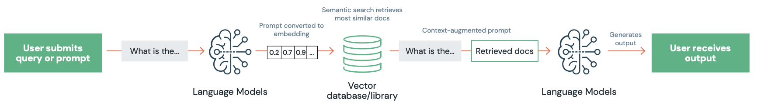
Retrieval Augmented Generation (RAG)
LLMOps - Key components
Dynamic solution to a fundamental limitation of LLMs:
Their inability to access information beyond their training data cut-off point.
Connects static LLMs with real-time data retrieval
Inject relevant information from external sources into the context provided to a LLM
Example: Question-answering use case where the answer might evolve over time, or come from up-to-date, domain-specific documents that were not part of the model’s original training data.
Embedding Model
Language Model

Slide 25

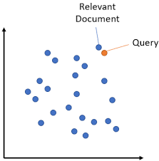



Retrieval Augmented Generation (RAG)
LLMOps - Key components
Generate Embeddings
Language Model converts docs to embeddings
Source PDF documents
!
Similar documents are passed as context/memory
User asks a question
Vector
similarity search
User receives an answer
LLM converts query to embeddings
LLM augments and generates completion
Notes:
User prompt: The process begins with a user query or prompt. This input serves as the foundation for what the RAG system aims to retrieve.
Embedding conversion: The user’s prompt is transformed into a high-dimensional vector (or embedding). This representation captures the semantic essence of the prompt and is used to search for relevant information in the database.
Information retrieval: Using the prompt’s vector representation, RAG queries the external data sources or databases. A vector database (see below) can be particularly effective here, allowing for efficient and accurate data fetching based on similarity measures.
Context augmentation: The most relevant pieces of information are retrieved and concatenated to the initial prompt. This enriched context provides the LLM with supplemental information which can be used to produce a more informed response.
Response Generation: With the augmented context, the language model processes the combined data (original prompt + retrieved information) and generates a contextually relevant response.
Feedback Loop: Some RAG implementations might encompass a multi-hop feedback mechanism (see the following paper for an example). In cases where the response is deemed unsatisfactory, the system can revisit its search criteria, tweak the context, or even refine its retrieval strategy, subsequently generating a new answer.

Slide 26
Retrieval Augmented Generation (RAG)
LLMOps - Key components
Benefits
Benefit | Explanation
LLMs as reasoning engines rather than a static artifacts | RAG ensures that model responses are not just based on static training data. LLM used as a reasoning engine augmented with external data sources to provide up-to-date, accurate and relevant responses.
Reduce hallucinations | Grounding the model’s input on external knowledge, RAG attempts to mitigate the risk of producing “hallucinations”
Domain-specific contextualization | Can be tailored to interface with proprietary or domain-specific data. Ensures that the LLM’s outputs are not only accurate but also contextually relevant, catering to specialized queries or domain-specific needs.
Efficiency and cost-effectiveness | RAG can offer an alternative to fine-tuning LLMs by enabling in-context learning without the overhead of fine-tuning. Beneficial where models need to be frequently updated with new data. Note: RAG reduces development time and cost, fine-tuning by contrast reduces inference time and cost.

Slide 27
Vector Databases
LLMOps - Key components
What are they?
Scalable, reliable production service
Stores vector representation of your data, often including metadata
Offers query(...) interface to return the most similar vectors to a given query vector
Query can optionally include hard filters or keyword-based queries
Offer full CRUD (create, read, update, delete) operations, allowing dynamic adjustments without rebuilding the entire index.
Notes:
go/vectorsearch/deck

Slide 28
Common Vector Database use cases
LLMOps - Key components
Retrieval Augmented Generation (RAG, such as document Q&A)
Semantic search
Recommendations
Anomaly detection
…many others…
Notes:
Disvcussion: what other use cases do you have?

Slide 29
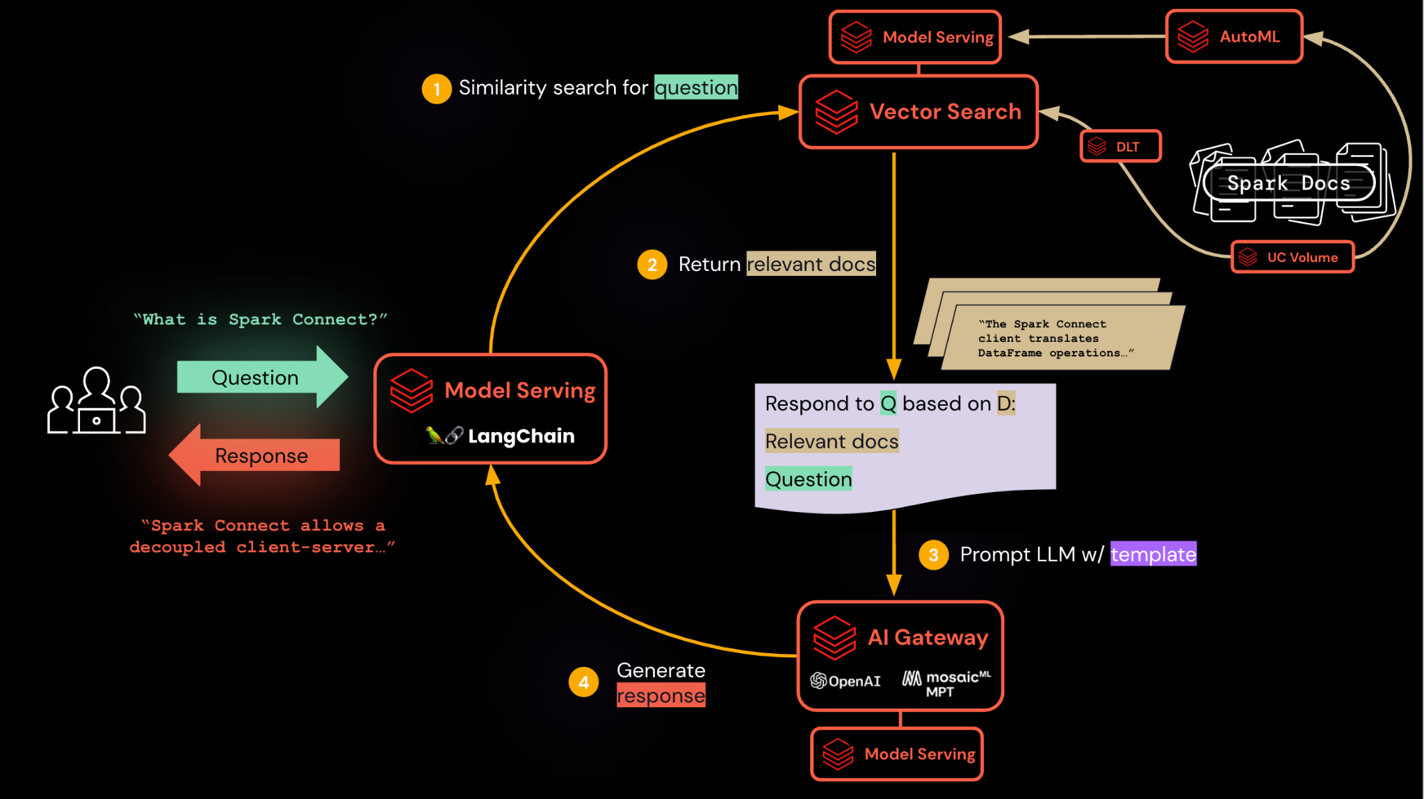
Blueprint for a Q&A bot
Notes:
go/vectorsearch/deck

Slide 30
LLMOps
What changes with LLMs?
Key components of LLM-powered applications
Prompt engineering
RAG
Vector databases
Fine-tuning LLMs
Third-party APIs vs self-hosted models
Evals
Packaging models/pipelines for deployment
Inference
Managing cost/performance trade-offs
Reference architecture
Resources

Slide 31
Third-party APIs vs self-hosted models
LLMOps - Key components
Data security and privacy:
Using third-party APIs often involves sending data to external servers.
Can pose risks, especially when dealing with sensitive or proprietary information.
Regulations may simply prohibit data leaving data regions, or being sent to non-compliant environments.
Hosting your own model ensures that data does not leave your secure environment, while retaining full access to the trained model.
Predictable and stable behavior:
Proprietary SaaS models can undergo updates or changes without prior notice.
Changes can lead to unpredictable model behavior.
Hosting your own LLM, you have full control over its versions and updates.
Vendor lock-in:
Third-party APIs means being dependent on the vendor’s terms, pricing, and availability.
Risk of the service being deprecated or price changes.
By self-hosting, you maintain autonomy and guard against potential vendor lock-in.

Slide 32
LLMOps
What changes with LLMs?
Key components of LLM-powered applications
Prompt engineering
RAG
Vector databases
Third-party APIs vs self-hosted models
Evals
Packaging models/pipelines for deployment
Inference
Managing cost/performance trade-offs
Reference architecture
Resources

Slide 33
Evaluation
LLMOps - Key components
Challenging and evolving domain
Challenging and evolving domain - LLMs often demonstrate uneven capabilities across different tasks.
Excel in one benchmark, but slight variations in the prompt or problem can drastically affect its performance.
Present challenges:
Variable performance: LLMs sensitive to prompt variations
Lack of ground truth: Traditional NLP metrics (BLEU, ROUGE, etc.) fall short
Example: Summarizing a news article. Two equally good summaries might have almost completely different words and word orders; defining a “ground-truth” becomes difficult or impossible.
Domain-specific evaluation: For domain-specific fine-tuned LLMs, popular generic benchmarks may not capture their nuanced capabilities. When tailored for specific tasks, traditional metrics less relevant.
Reliance on human judgment: In domains where text is scarce or there is a reliance on subject matter expert knowledge, evaluating LLM output can be costly and time consuming.
Notes:
Variable performance: LLMs can be sensitive to prompt variations, demonstrating high proficiency in one task but faltering with slight deviations in prompts.
Lack of ground truth: Since most LLMs output natural language, it is very difficult to evaluate the outputs via traditional NLP metrics (BLEU, ROUGE, etc.). For example, suppose an LLM were used to summarize a news article. Two equally good summaries might have almost completely different words and word orders, so even defining a “ground-truth” label becomes difficult or impossible.
Domain-specific evaluation: For domain-specific fine-tuned LLMs, popular generic benchmarks may not capture their nuanced capabilities. Such models are tailored for specialized tasks, making traditional metrics less relevant. This divergence often necessitates the development of domain-specific benchmarks and evaluation criteria. See the example of Replit’s code generation LLM.
Reliance on human judgment: It is often the case that LLM performance is being evaluated in domains where text is scarce or there is a reliance on subject matter expert knowledge. In such scenarios, evaluating LLM output can be costly and time consuming.

Slide 34
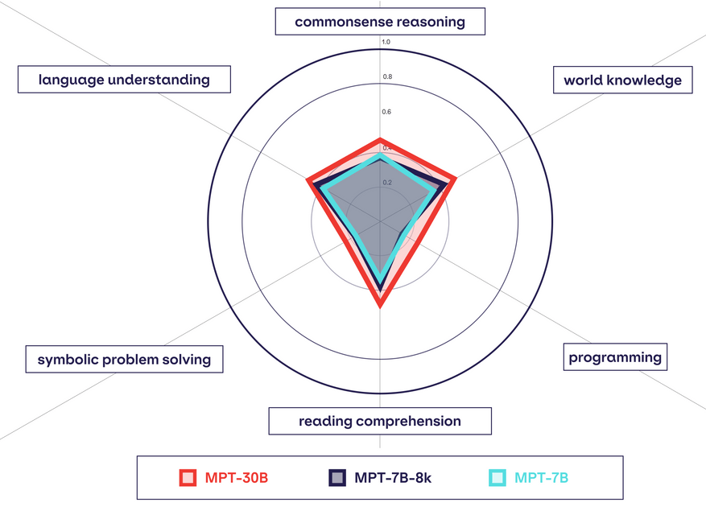
Evaluation
LLMOps - Key components
Current landscape
Benchmarks
BIG-bench (Beyond the Imitation Game benchmark)
EluetherAI LM Evaluation Harness
Mosaic Model Gauntlet
LLMs as evaluators
LLMs assisting with evaluation (Databricks blog post)
Faster than human evaluation
Cost-effectiveness
Potentially comparable to human evaluators
Human feedback in evaluation
Build human feedback into LLM applications
Notes:
Human feedback in evaluation
While human feedback is important in many traditional ML applications, it becomes much more important for LLMs. Humans - ideally your end users - become essential for validating LLM output. While you can pay human labelers to compare or rate model outputs (or have an LLM evaluate your application as mentioned above), the best practice for user-facing applications is to build human feedback into the applications from the outset. For example, a tech support chatbot may have a “click here to chat with a human” option, which provides implicit feedback indicating whether the chatbot’s responses were helpful. Explicit feedback can also be captured in this case by presenting users with the ability to click thumbs up/down buttons.

Slide 35
LLMOps
What changes with LLMs?
Key components of LLM-powered applications
Prompt engineering
RAG
Vector databases
Third-party APIs vs self-hosted models
Evals
Packaging models/pipelines for deployment
Inference
Managing cost/performance trade-offs
Reference architecture
Resources

Slide 36


Deployment
LLMOps - Key components
Packaging models/pipelines
With LLMs, it is common to package ML logic in new forms. These may include:
A lightweight call to an LLM API service (third-party or internal)
A “chain” from LangChain, LlamaIndex etc.
The chain may call an LLM API or a local LLM model.
An LLM or an LLM+tokenizer pipeline, such as a Hugging Face pipeline.
May use a pretrained model or a custom fine-tuned model.
An engineered prompt, possibly stored as a template in a tool such as LangChain.

Slide 37
Deployment
LLMOps - Key components
Packaging models/pipelines
With LLMs, it is common to package ML logic in new forms. These may include:
A lightweight call to an LLM API service (third-party or internal)
A “chain” from LangChain, LlamaIndex etc.
The chain may call an LLM API or a local LLM model.
An LLM or an LLM+tokenizer pipeline, such as a Hugging Face pipeline.
May use a pretrained model or a custom fine-tuned model.
An engineered prompt, possibly stored as a template in a tool such as LangChain.
MLflow can be used to package LLMs and LLM pipelines for deployment. Built-in model flavors include:
PyTorch and TensorFlow
Hugging Face Transformers (relatedly, see Hugging Face Transformers’ MLflowCallback)
LangChain
OpenAI API
(See the documentation for a complete list)
All of the above still constitute models and pipelines!

Slide 38
LLMOps
What changes with LLMs?
Key components of LLM-powered applications
Prompt engineering
RAG
Vector databases
Third-party APIs vs self-hosted models
Evals
Packaging models/pipelines for deployment
Inference
Managing cost/performance trade-offs
Reference architecture
Resources

Slide 39
Inference
LLMOps - Key components
Real-time inference
Ideal for applications requiring immediate responses, e.g. chat interfaces or question-answering systems.
Third-party LLM API with pre- and post- processing logic:
Some inference pipelines (e.g. RAG) include pre-processing and post-processing logic, and use an external LLM API to generate output.
Databricks Model Serving - deploy as REST API endpoints
LLM pipelines making requests to external APIs - CPU instance types are sufficient.
MLflow AI Gateway can be used to manage requests to different LLM API providers:
Standardize interactions with SaaS and OSS LLMs for such LLM pipelines
High-level interface simplifying the interaction with these services by providing a unified endpoint to handle specific LLM related requests.
Pre-trained or fine-tuned OSS LLMs:
When hosting your own LLMs, (e.g. downloaded from repositories like Hugging Face, and additionally fine-tuned), GPU instance types are typically required for optimized inference.
Batch inference
Scenarios where immediate feedback is not critical (e.g. offline text summarization)
Spark can be leveraged to distribute inference across multiple machines (GPUs included).

Slide 40
LLMOps
What changes with LLMs?
Key components of LLM-powered applications
Prompt engineering
RAG
Vector databases
Third-party APIs vs self-hosted models
Evals
Packaging models/pipelines for deployment
Inference
Managing cost/performance trade-offs
Reference architecture
Resources

Slide 41
Managing cost/performance
LLMOps - Key components
Start simple, but plan for scaling:
Speed of development is key, so it is acceptable to use more expensive options, such as paid APIs for existing models.
As you go, make sure to collect data such as queries and responses.
Scope out your costs: (example questions from Professional Services LLM scoping doc)
How many queries per second do you expect?
Will requests come in bursts?
How much does each query cost?
These estimates will inform you about project feasibility and will help you to decide when to consider bringing the model in-house with open source models and fine-tuning.
Reduce costs by tweaking LLMs and queries:
Many LLM-specific techniques for reducing computation and costs.
Shortening queries, tweaking inference configurations, and using smaller versions of models.
Get human feedback:
Easy to reduce costs but hard to say how changes impact your results unless you get human feedback from end users.

Slide 42
LLMOps
What changes with LLMs?
Key components of LLM-powered applications
Prompt engineering
RAG
Vector databases
Third-party APIs vs self-hosted models
Evals
Packaging models/pipelines for deployment
Inference
Managing cost/performance trade-offs
Reference architecture
Resources

Slide 43
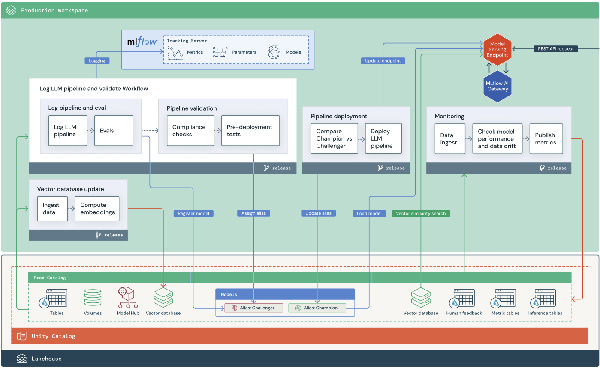
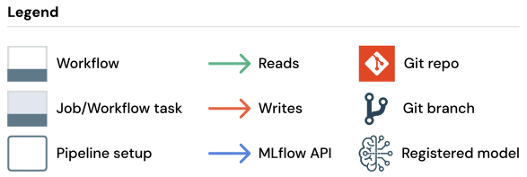
Production - RAG with a third-party LLM API

Slide 44
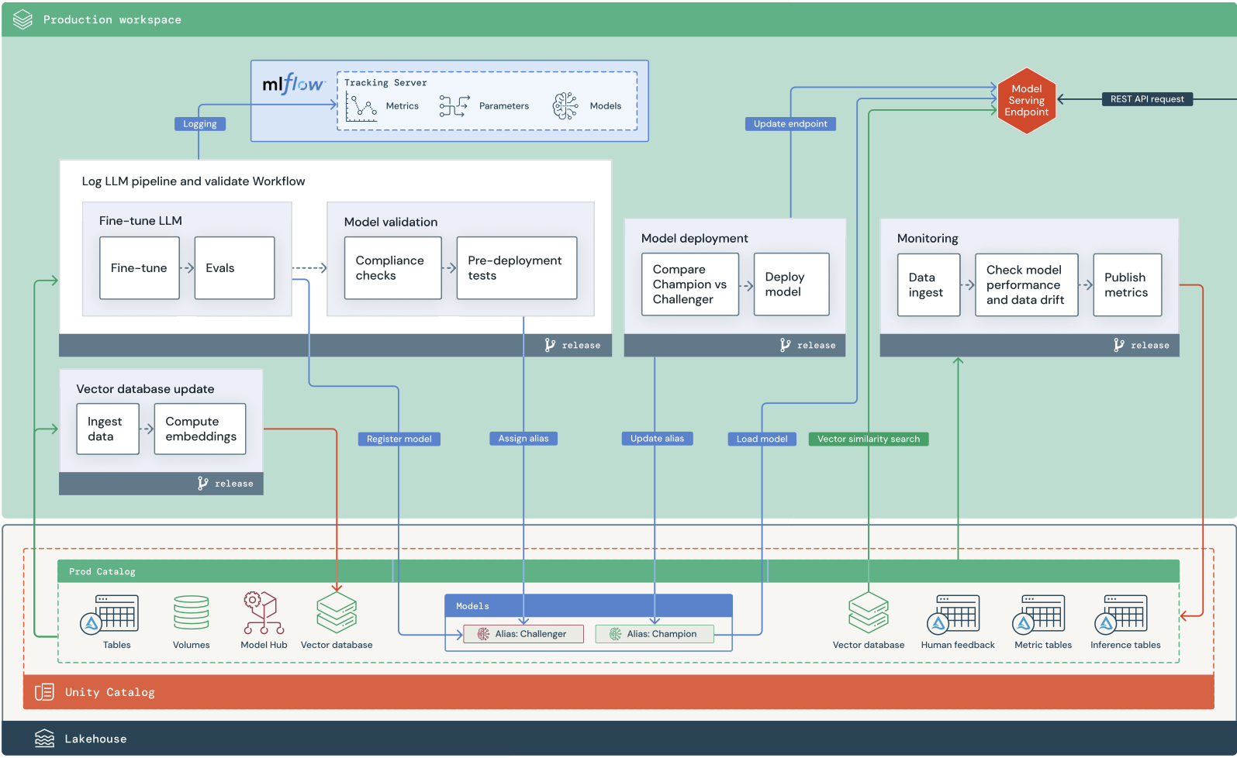
Production - RAG with a fine-tuned OSS model

Slide 45
LLMOps
What changes with LLMs?
Key components of LLM-powered applications
Prompt engineering
RAG
Vector databases
Fine-tuning LLMs
Pre-training from scratch
Third-party APIs vs self-hosted models
Evals
Packaging models/pipelines for deployment
Inference
Managing cost/performance trade-offs
Reference architecture
Resources

Slide 46
Resources: Big Book MLOps eBook
[External] - Big Book of MLOps V2
Part 1: MLOps deck (go/mlops/deck)

